Slide 1

Decision Trees & Random Forest

Slide 2
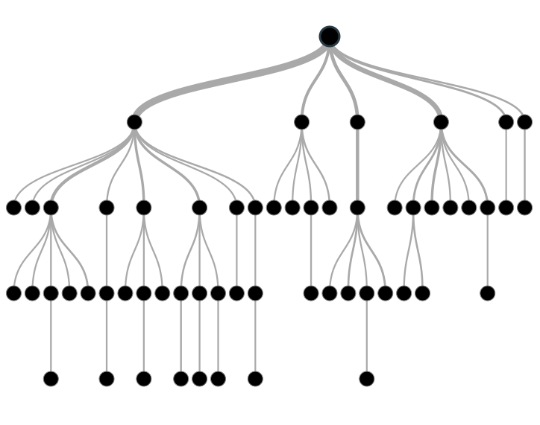
Classification and Regression Trees
• Grow a binary tree. • At each node, “split” the data into two “daughter” nodes.
Splits are chosen using a splitting criterion.
For regression the predicted value at a node is the average response variable for all observations in the node.
For classification the predicted class is the most common class in the node (majority vote).
For classification trees, can also get estimated probability of membership in each of the classes
Bottom nodes are “terminal” nodes.

Slide 3
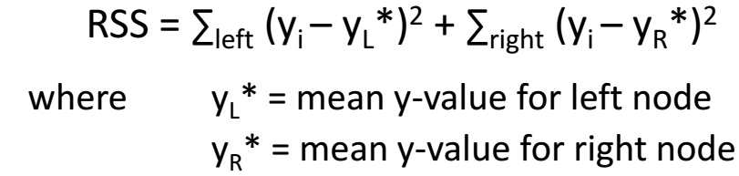
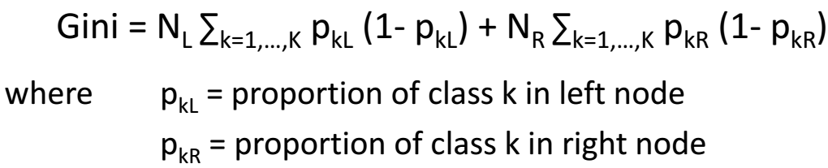

Splitting criterion
Regression: residual sum of squares
Classification: Gini criterion
Standard deviation
Notes:
Gini impurity is a measure of how often a randomly chosen element from the set would be incorrectly labeled if it was randomly labeled according to the distribution of labels in the subset.
Gini impurity can be computed by summing the probability {\displaystyle f_{i}} of an item with label {\displaystyle i} being chosen times the probability {\displaystyle 1-f_{i}} of a mistake in categorizing that item. It reaches its minimum (zero) when all cases in the node fall into a single target category.

Slide 4
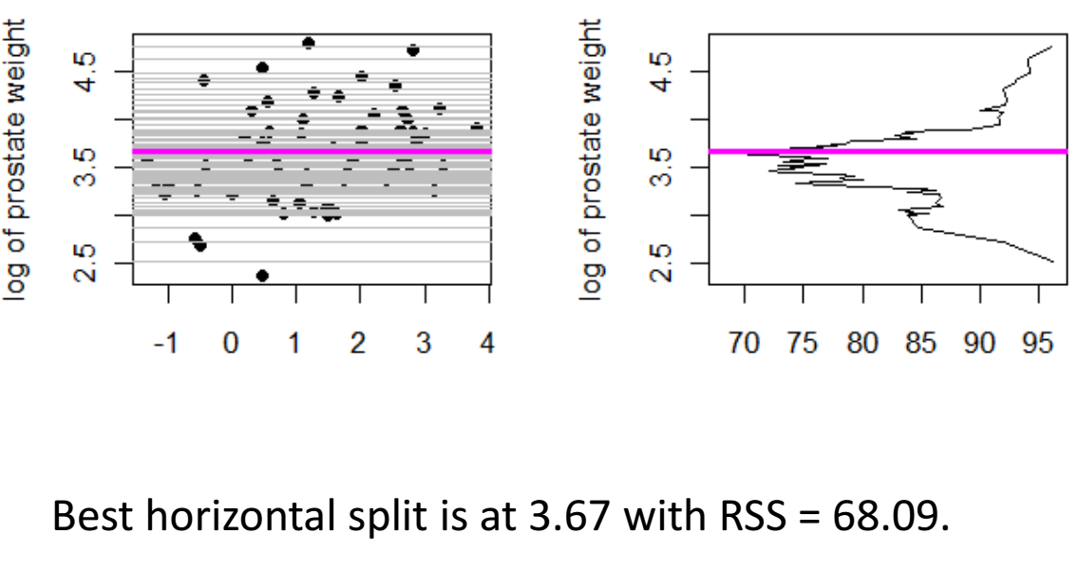
Cancer Example
Adele Cutler
Utah State University

Slide 5
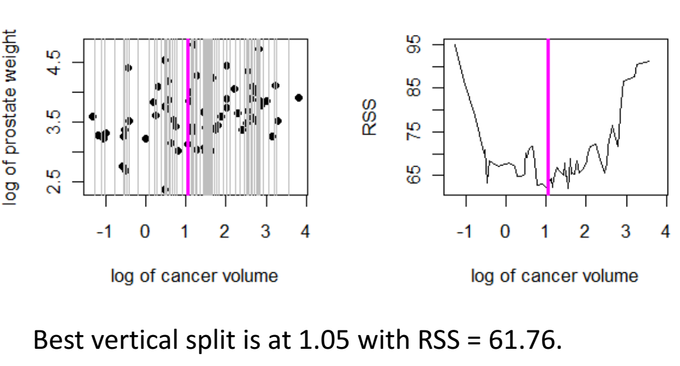
Adele Cutler
Utah State University

Slide 6
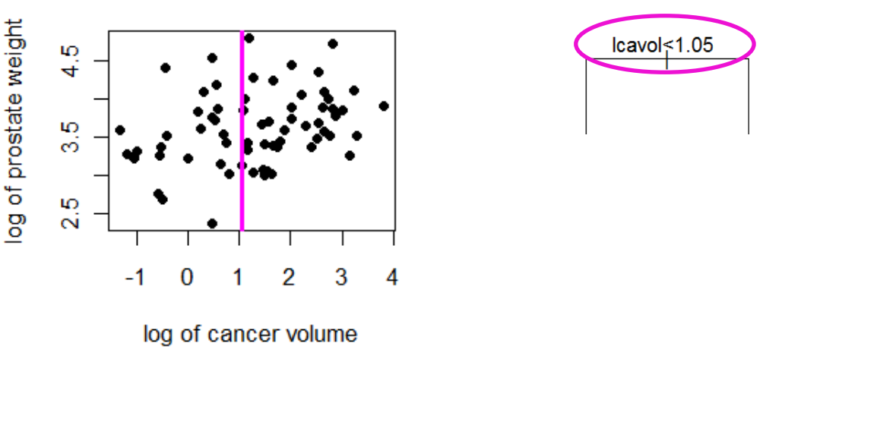
Adele Cutler
Utah State University

Slide 7
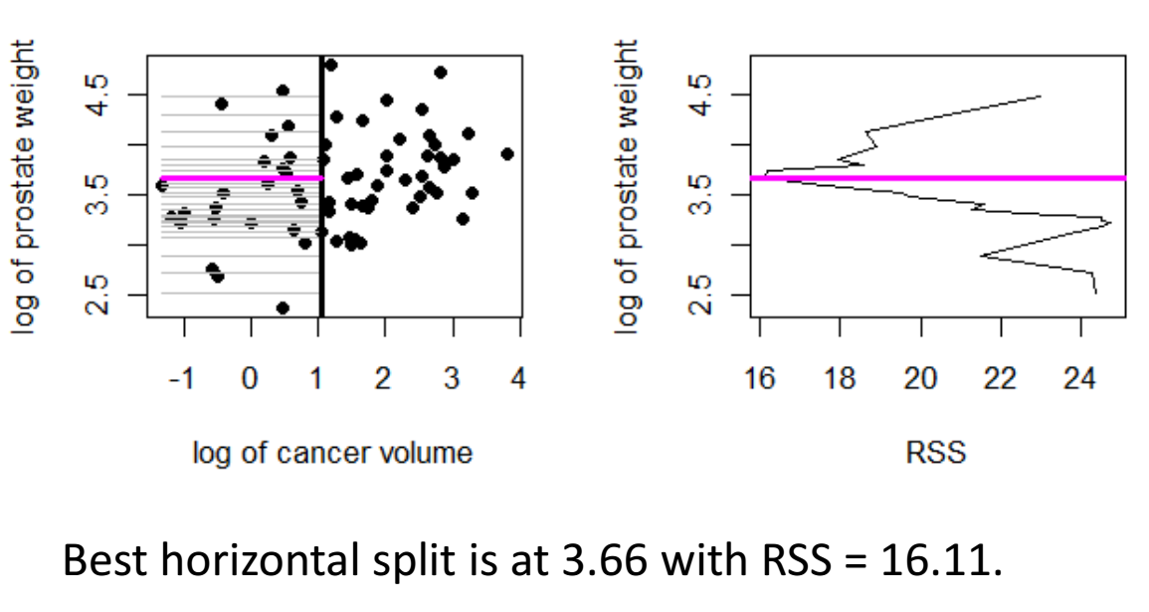
Adele Cutler
Utah State University

Slide 8
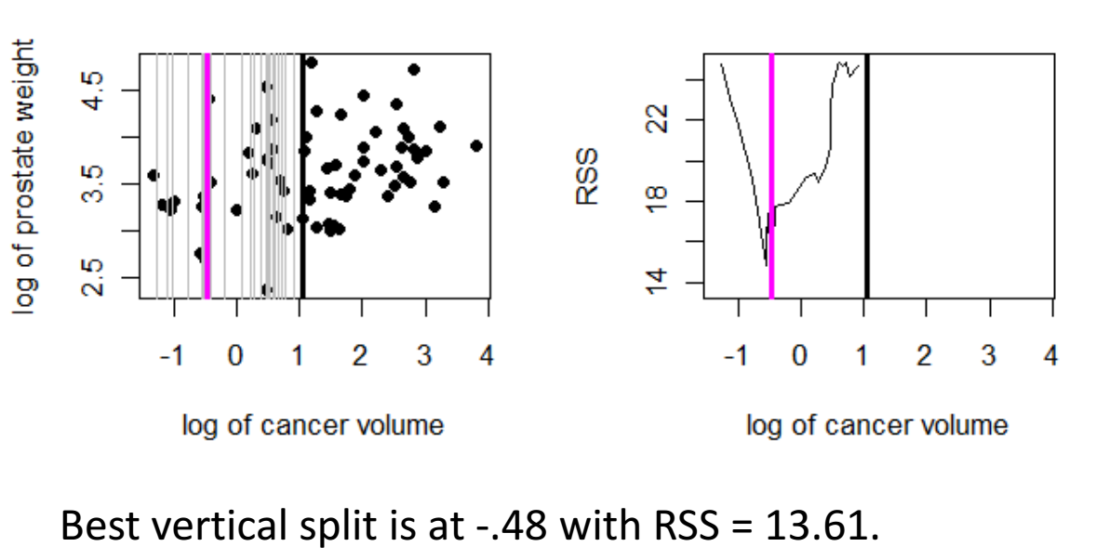
Adele Cutler
Utah State University

Slide 9
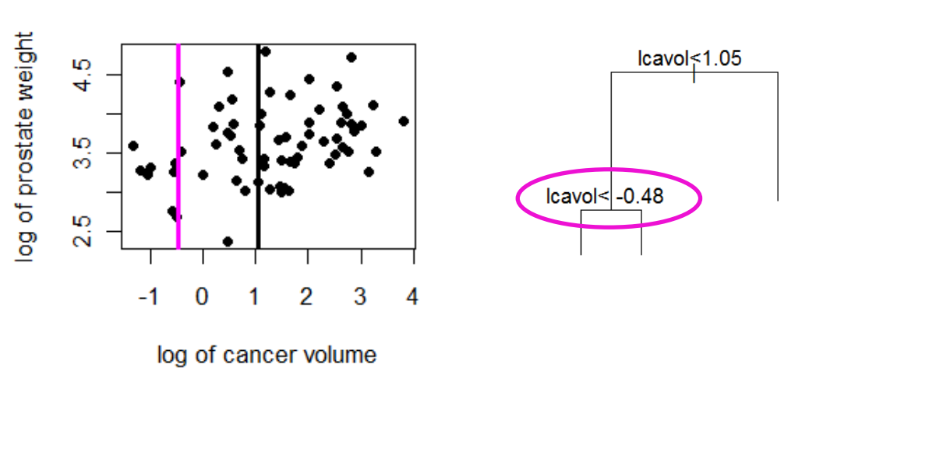
Adele Cutler
Utah State University

Slide 10
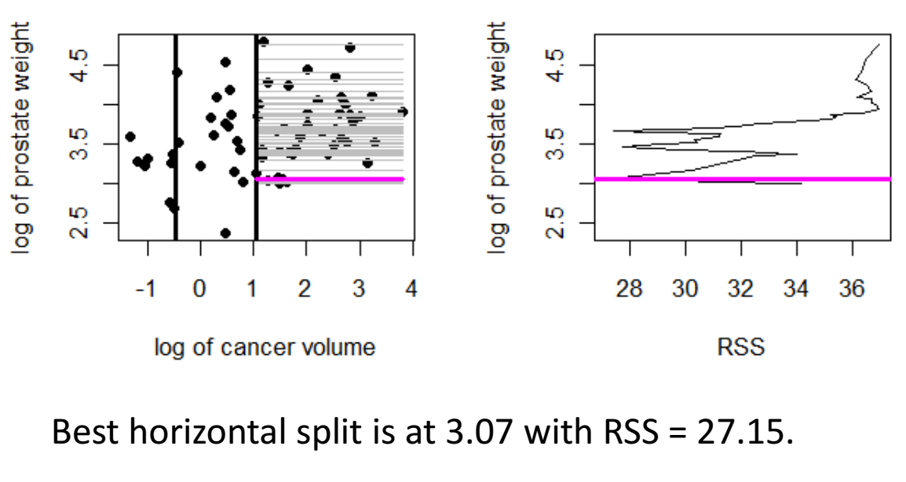
Adele Cutler
Utah State University

Slide 11
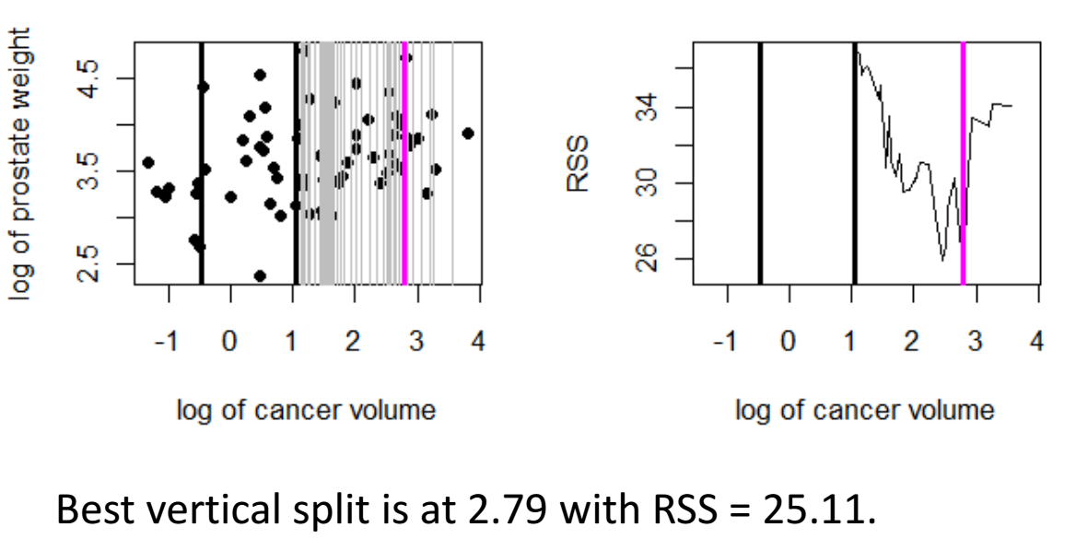
Adele Cutler
Utah State University

Slide 12
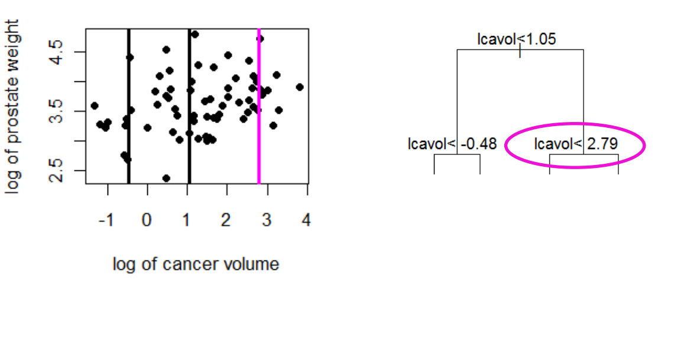
Adele Cutler
Utah State University

Slide 13
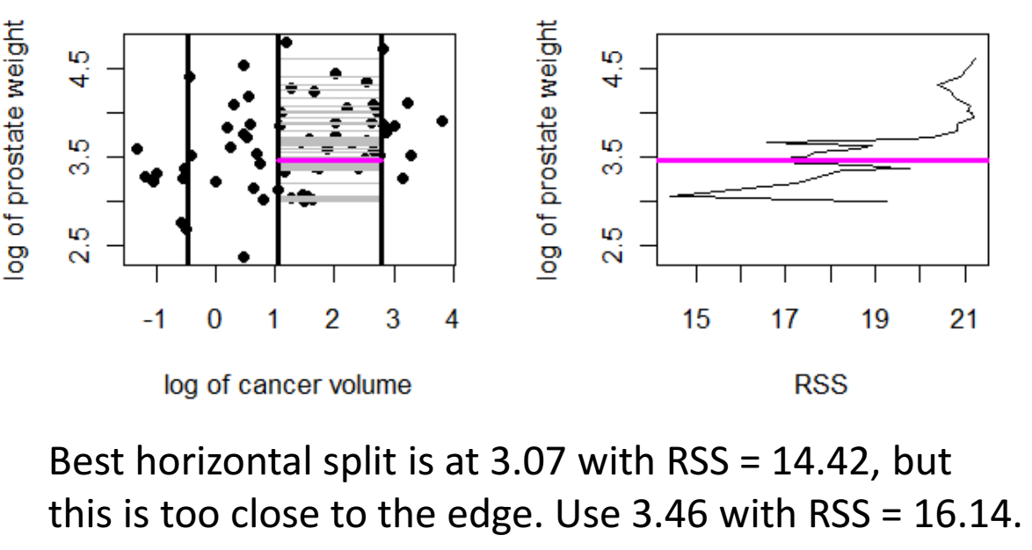
Adele Cutler
Utah State University

Slide 14
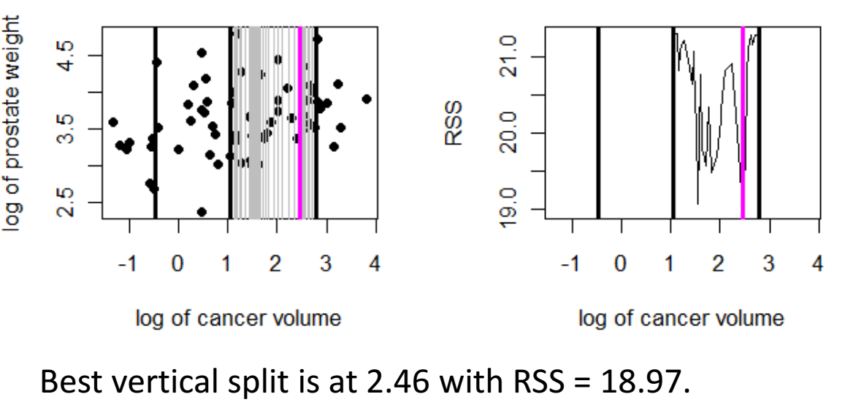
Adele Cutler
Utah State University

Slide 15
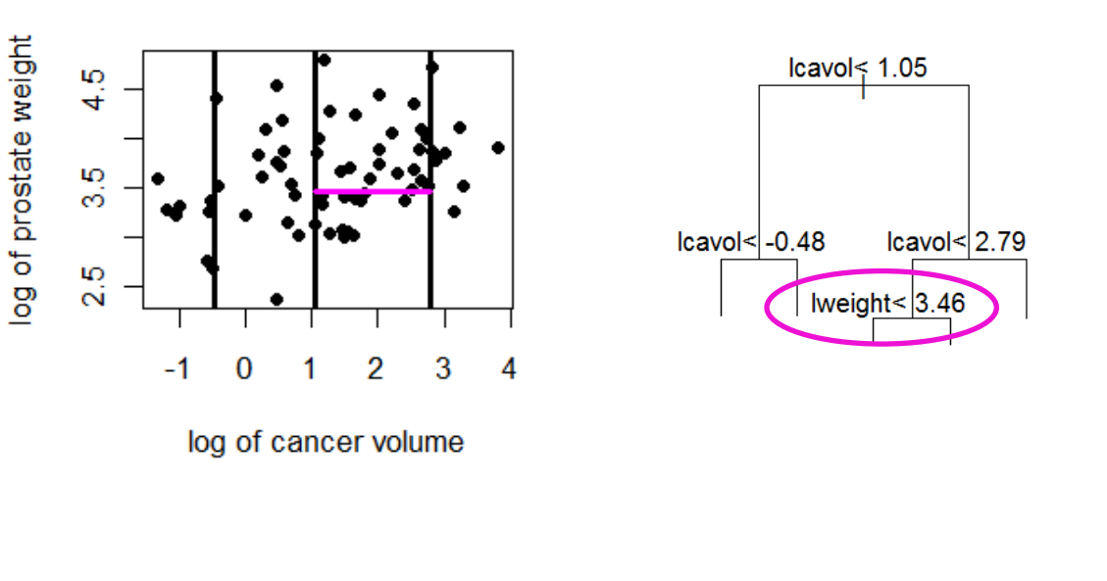
Adele Cutler
Utah State University

Slide 16
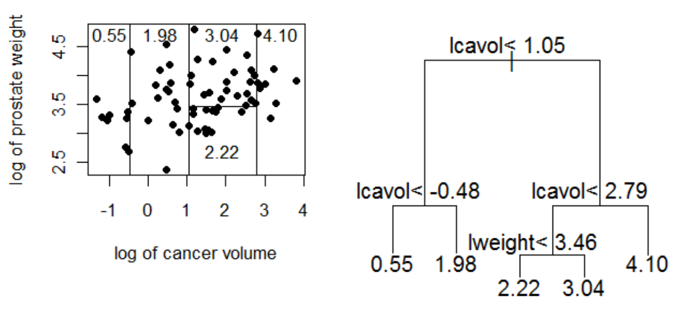
Final Tree
Adele Cutler
Utah State University

Slide 17
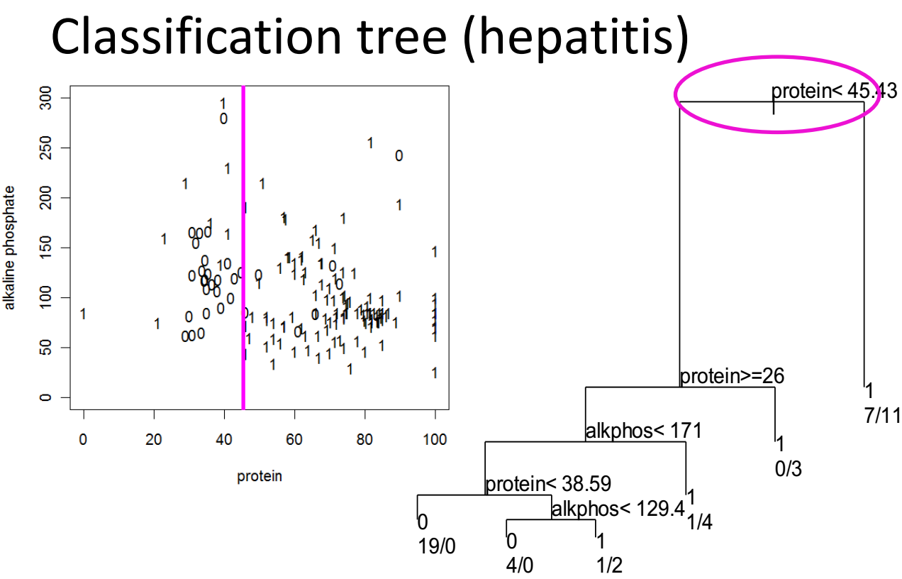
Adele Cutler
Utah State University

Slide 18
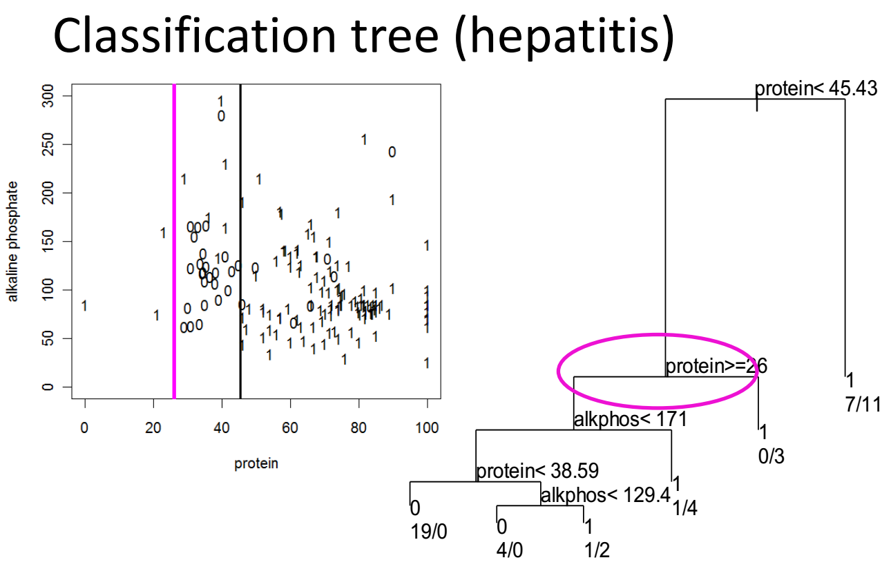
Adele Cutler
Utah State University

Slide 19
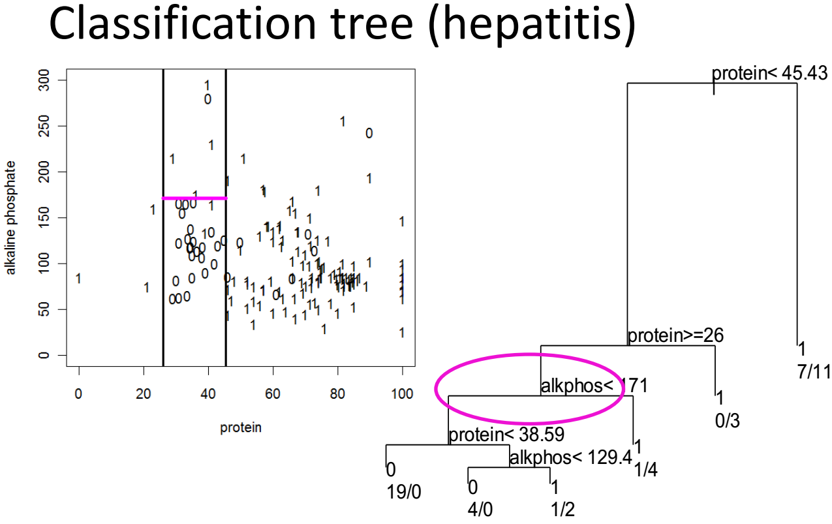
Adele Cutler
Utah State University

Slide 20
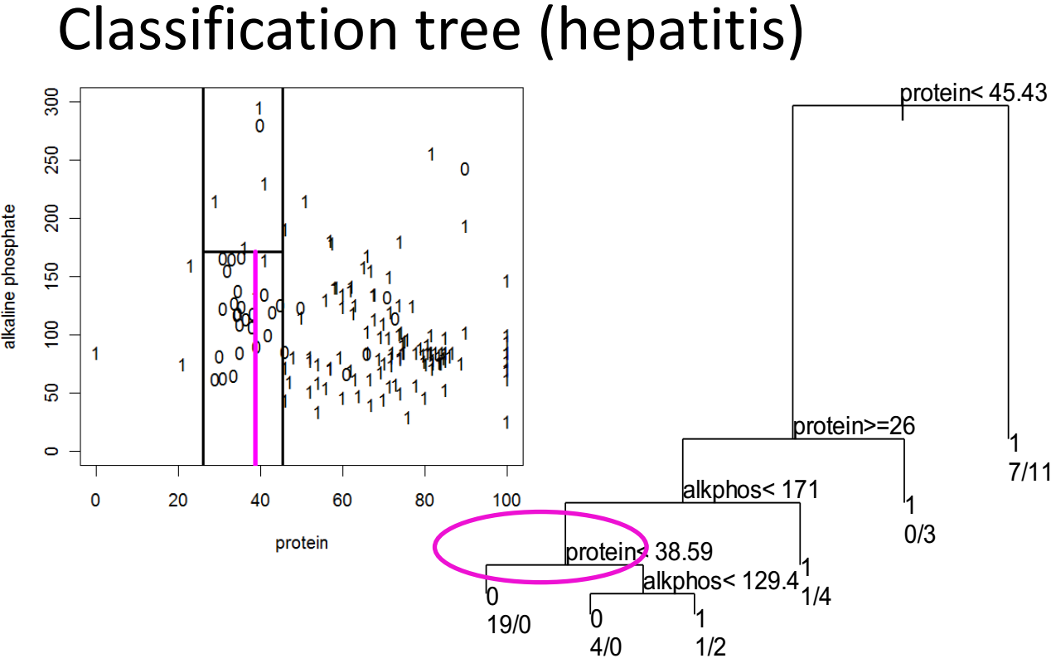
Adele Cutler
Utah State University

Slide 21
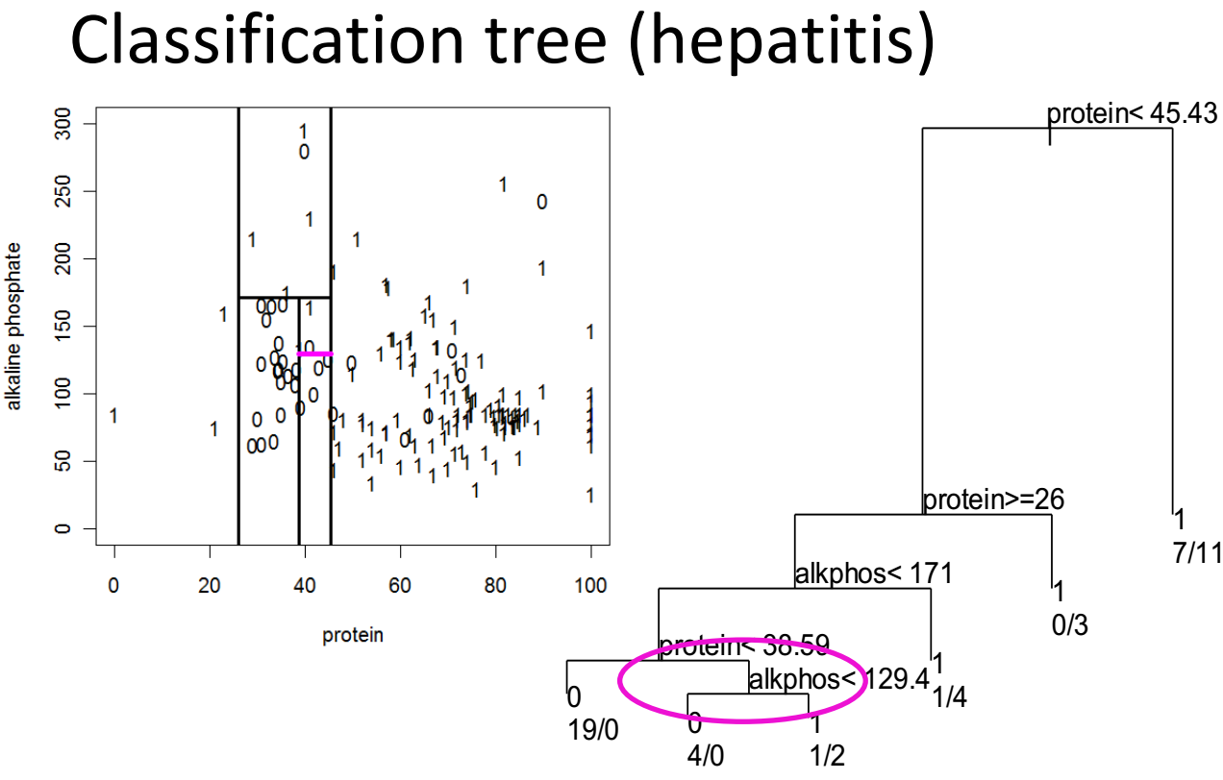
Adele Cutler
Utah State University

Slide 22
Random forest

Slide 23

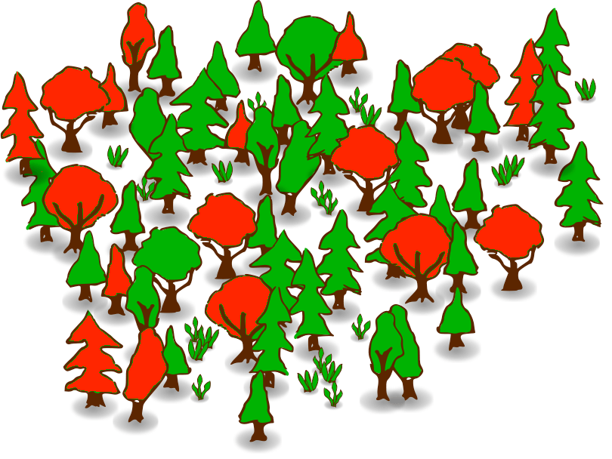
Random forest

